Slide 1
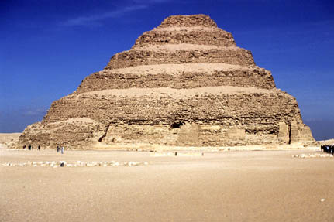
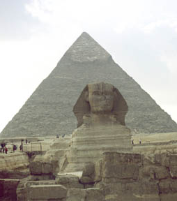
PYRAMIDS OF THE OLD KINGDOM

Slide 2
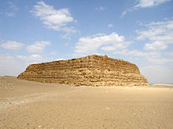
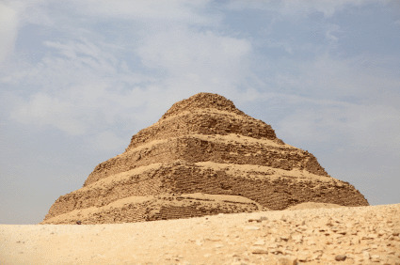
Pyramids
Mac’s History
The development of pyramids began with structures known as mastabas – a rectangular, flat-roofed structure built with mud bricks or stones
Built during the Early Dynastic Period as the tombs of the pharaohs
The idea to stack one mastaba on top of another to create the first step pyramid came from a man named Imhotep – vizier of the Pharaoh Djoser

Slide 3
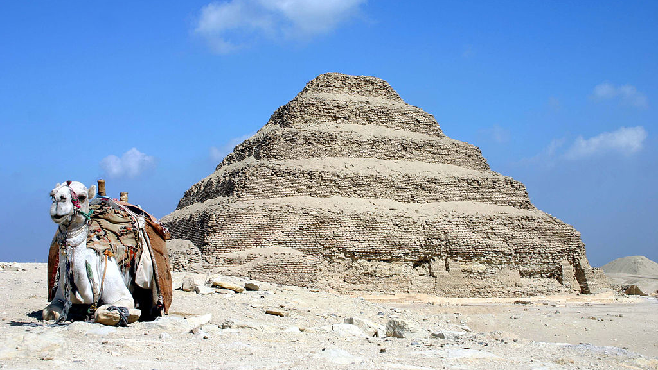
Mac’s History
Step Pyramid of Djoser

Slide 4
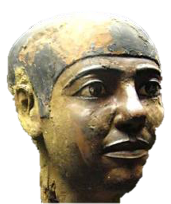
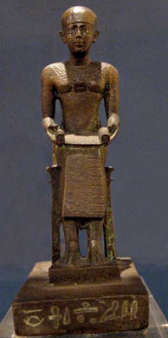
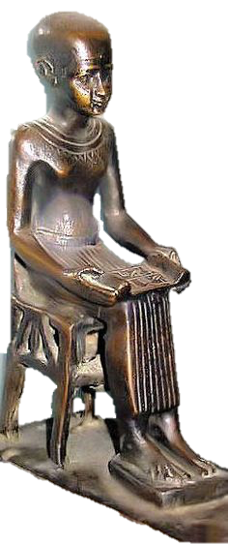
Imhotep
Mac’s History
Imhotep c. 2650-2600 BCE – his name means “one who comes in peace”
Considered the world’s first genius
Imhotep was the first non-ruler in history whose life was recorded and passed down through history

Slide 5
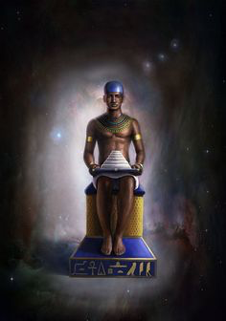
Imhotep
Mac’s History
The design of the step pyramid established the Old Kingdom as an era of remarkable achievement
It remains the oldest surviving building made from cut blocks of stone
The pharaohs of the Fourth Dynasty, inspired by Imhotep’s design, would push the boundaries of what was possible further and build the Great Pyramids of Giza

Slide 6
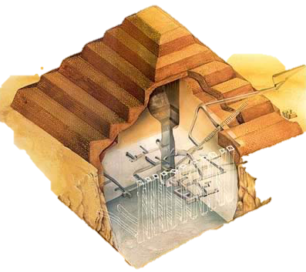
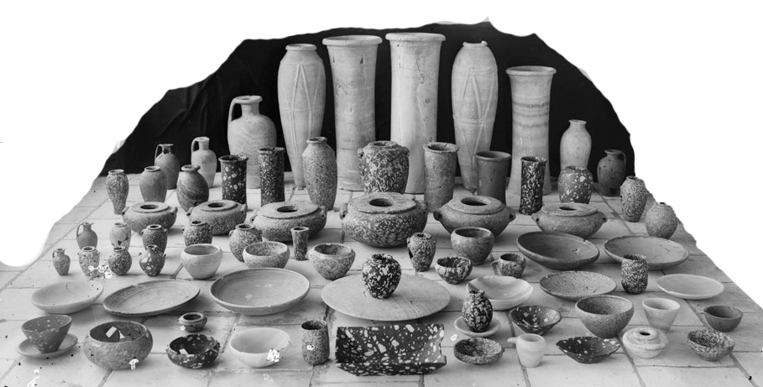
Imhotep
Mac’s History
Inside the step Pyramid, Imhotep immortalized in stone every aspect of life within the royal palace
Furniture, straw baskets, metal pots, stories and exploits of the Pharaoh, his family, and Imhotep were all sculpted in stone

Slide 7
Imhotep
Mac’s History
“The Chancellor of the King of Lower Egypt, the first after the King of Upper Egypt, administrator of the great palace, hereditary lord, the High Priest of Heliopolis, Imhotep the builder, the sculptor, and maker of stone vases.”
Inscription on a statue of Imhotep in the royal funeral complex

Slide 8
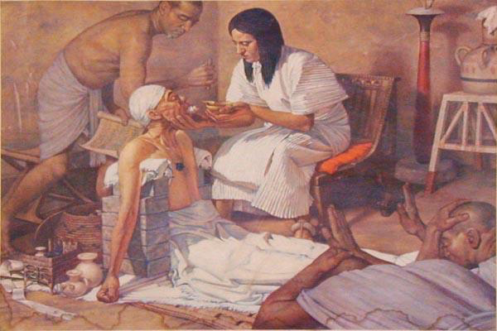
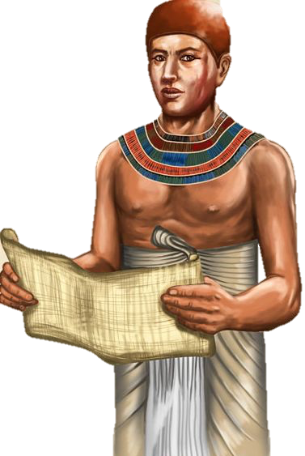
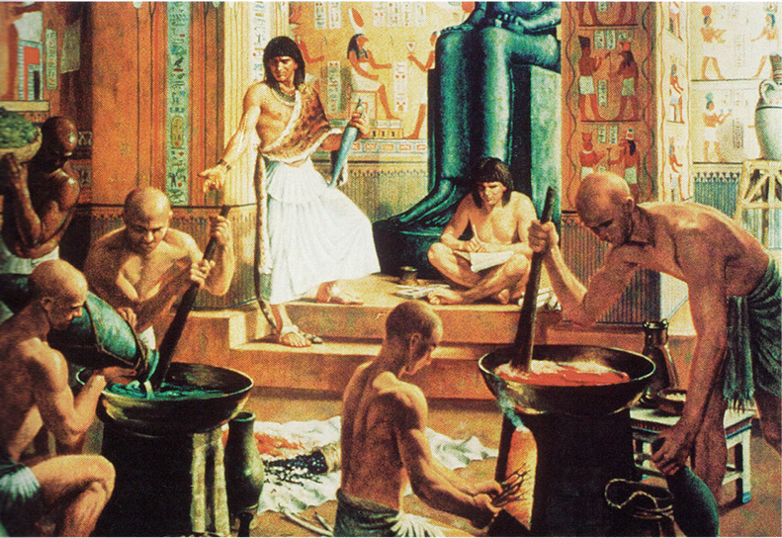
Imhotep
Mac’s History
Imhotep’s genius extended beyond architecture
Founder of the Egyptian system of medicine – regarded as the best in the ancient world for centuries
Imhotep was revered upon his death and later worshiped as a god in Egypt and as far away as Greece

Slide 9
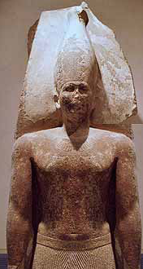
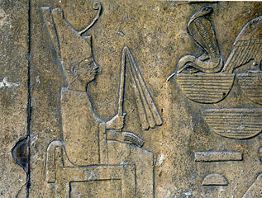
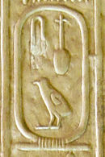
Sneferu’s Pyramids
Mac’s History
The first ‘true’ pyramid was created during the 4th dynasty which saw the Old Kingdom reach its apex
Sneferu, first pharaoh of the 4th dynasty, would build three pyramids before perfecting the ‘true’ pyramid
Video 1

Slide 10
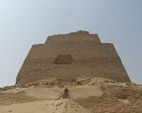
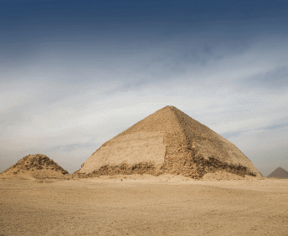
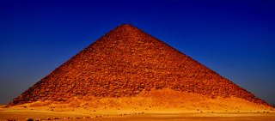
Sneferu’s Pyramids
Mac’s History
First attempted to fill in the step pyramid at Medium but this collapsed under the added weight
Second attempt resulted in the Bent Pyramid when architects realized the angle was too steep
The third attempt was a success and the Red Pyramid would be history’s first ‘true’ pyramid

Slide 11
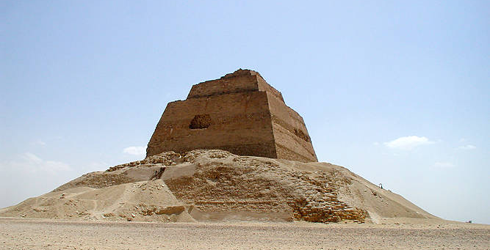
Mac’s History
Medium Pyramid of Sneferu

Slide 12
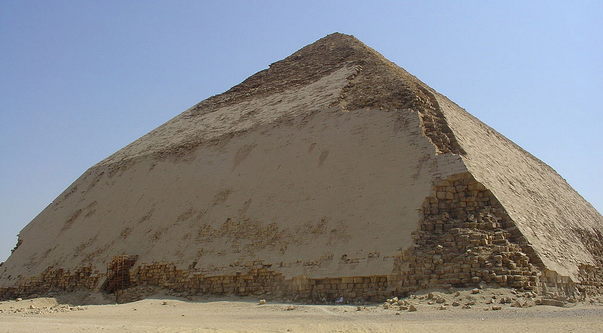
Mac’s History
Bent Pyramid of Sneferu

Slide 13
Mac’s History
Red Pyramid of Sneferu

Slide 14
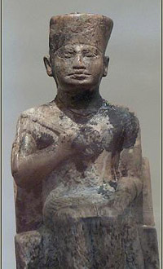
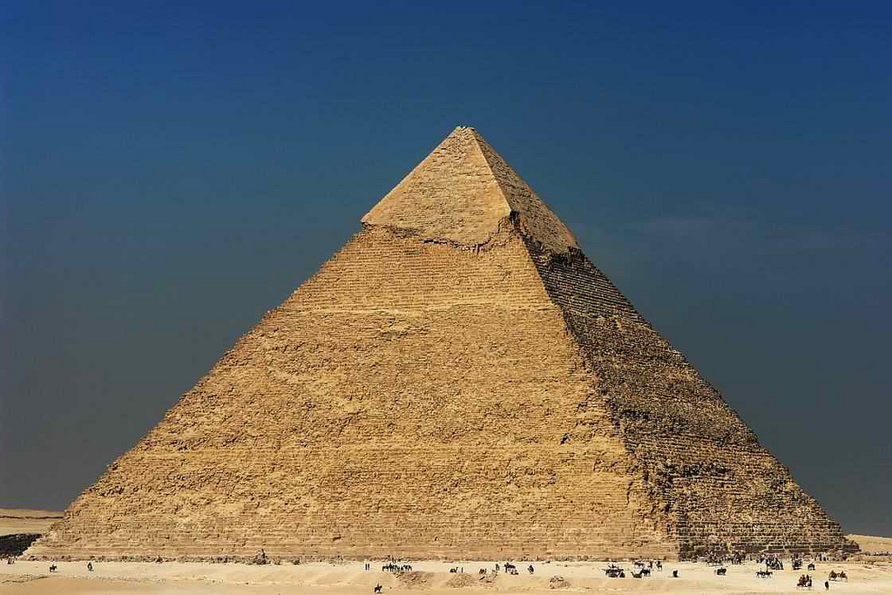
The Great Pyramid of Giza
Mac’s History
Khufu, son of Sneferu, would build the largest pyramid in Egypt’s history
The Great Pyramid was one of the seven wonders of the ancient world and the only one that remains
Was the tallest structure built by humans for almost 4000 years

Slide 15
Mac’s History
Great Pyramid of Giza

Slide 16
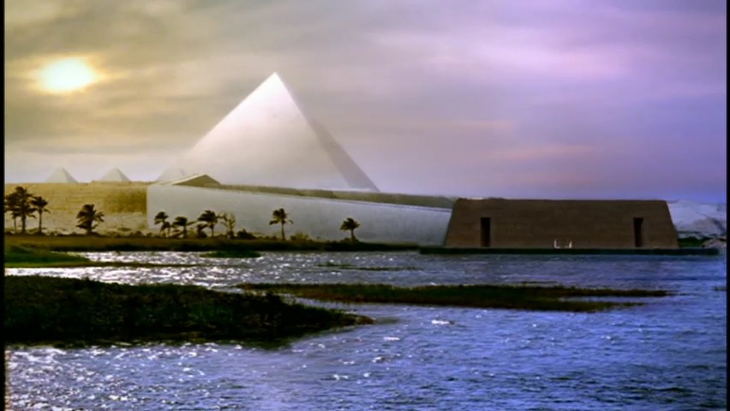
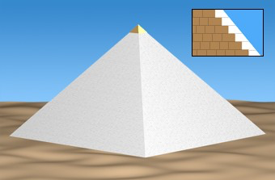
The Great Pyramids of Giza
Mac’s History
Originally the Great Pyramid was covered in smooth limestone that would have shone white in the distance
The limestone has since crumbled away and what is visible is the underlying stepped core structure

Slide 17
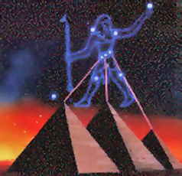
The Great Pyramid of Giza
Mac’s History
Before the Egyptians laid the first stone, precise measurements were taken using the stars as guides
One controversial theory suggests that all three pyramids of Giza – of which Khufu’s is the largest and oldest – are aligned with the Constellation of Orion
Video 2

Slide 18
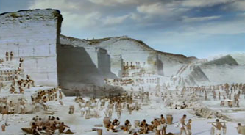
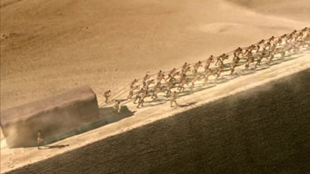
The Great Pyramid of Giza
Mac’s History
Exact mathematical calculations were needed to ensure the structural integrity of the pyramid
Estimated that 2.3 million blocks were used in the building of the Great Pyramid, most were quarried close by
The largest stones are in the King's chamber, weigh between 20 and 80 tons and were transported from 500 miles away
Video 3

Slide 19
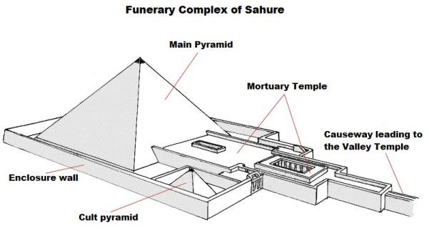
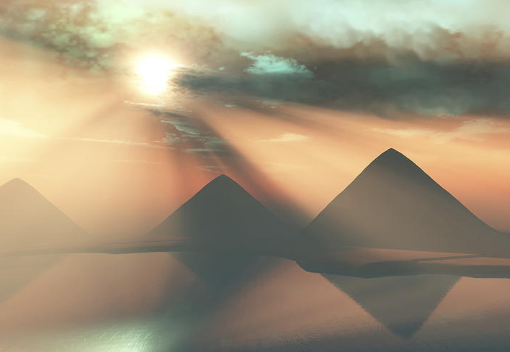
Pyramid Construction
Mac’s History
Pyramids were more than just tombs – they were part of great mortuary temple complexes where the pharaohs became gods
The tomb was dedicated to the worship of the pharaoh
The move towards the ‘true’ pyramid was an attempt by the Egyptians to emulate the rays of the sun which the pharaoh would ascend on a solar barque (mythical boat) to join the god Ra

Slide 20
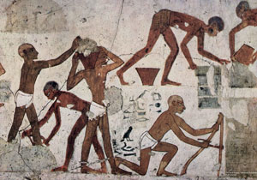
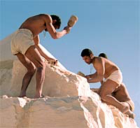
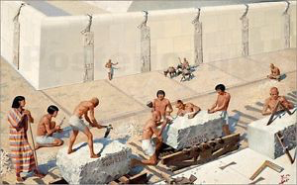
Pyramid Construction
Mac’s History
Historians now believe that the pyramids were built by skilled craftsmen and laborers, AND slaves
Every summer royal officials would head up and down the Nile selecting able-bodied men for the task of building the pharaoh’s tomb
Egyptians believed they owed everything to the pharaoh, and this was a way to repay him

Slide 21
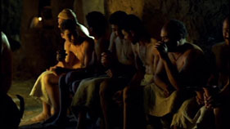
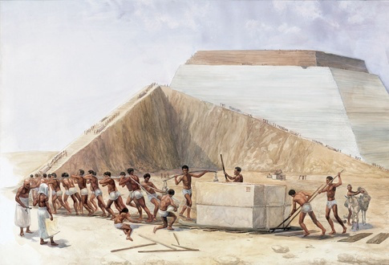
Pyramid Construction
Mac’s History
These men would be well provided for – paid in food and drink, clothing and housing, even skilled training for their children - Video 4
Egyptologists generally believe that the Great Pyramid took between 10 to 20 years to build with an average workforce of 14,000 men that may have reached 40,000 at the height of the project
A series of ramps and sleds were used to pull the massive stones into place – it is believed 1000 tons of stone was moved a day - Video 5

