Slide 1
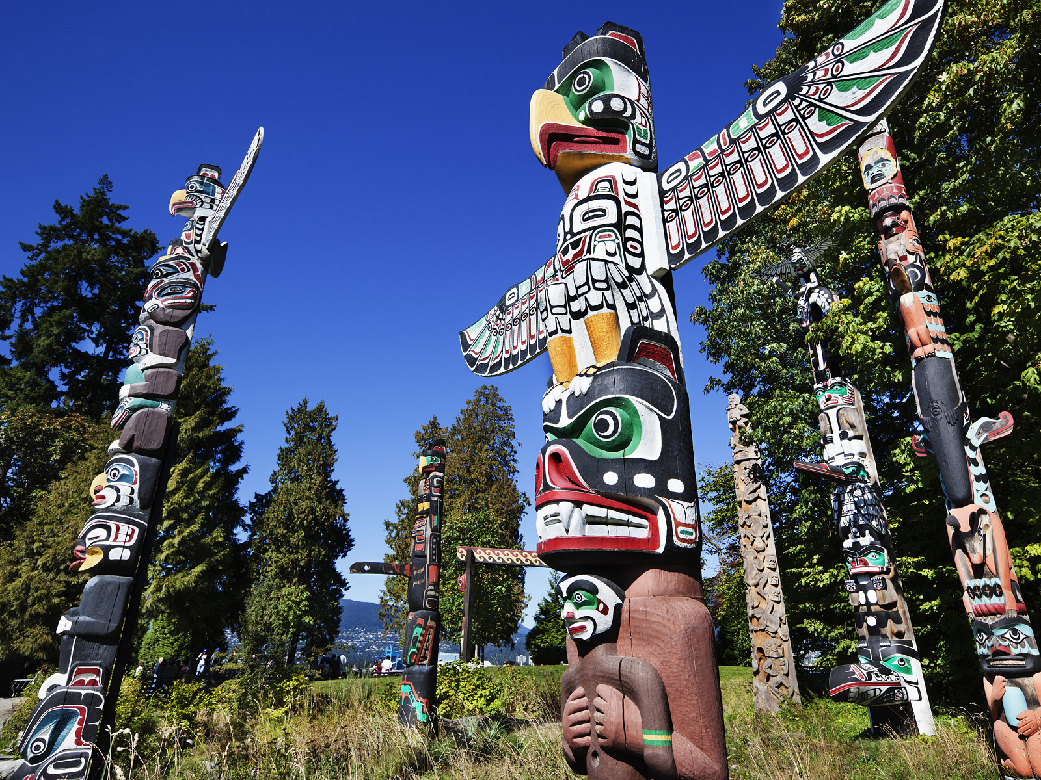
Relationship to the Land
The Importance of Place and Bond

Slide 2
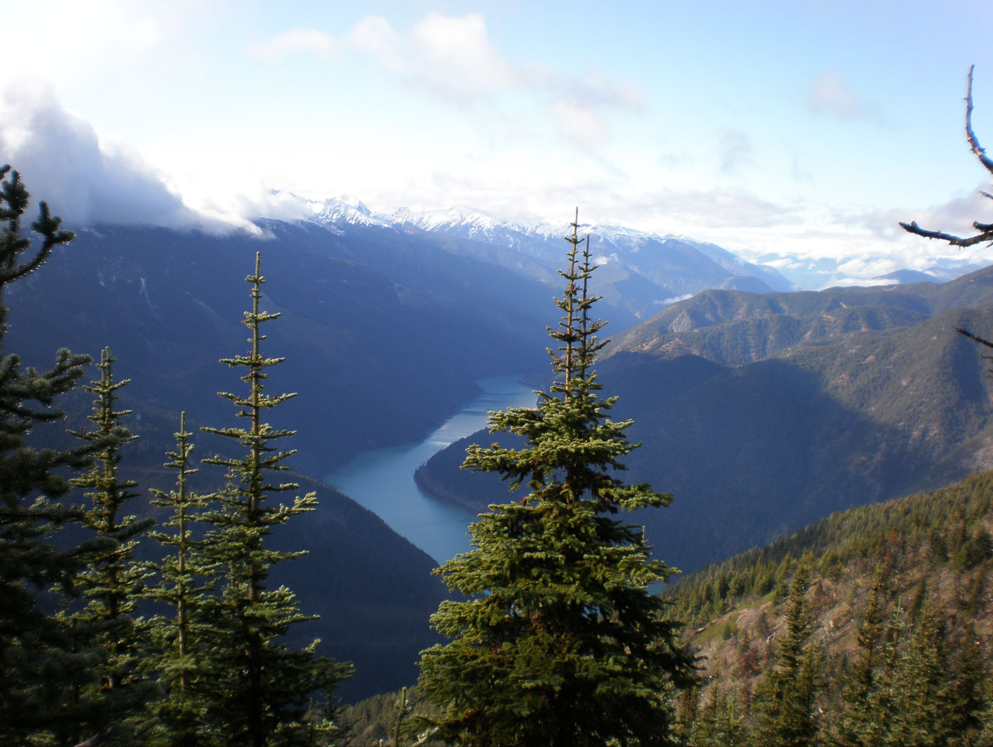
Shape
BC is defined as a land that has many, many mountains and a large amount of water.
Our four major river systems are: the Fraser, the Skeena, the Columbia, and the Peace Rivers. → These rivers provide us with transportation routes, living areas, and habitat for fish.
The mountains have provided us forests, food, plants, minerals, game, and fur bearing animals.
Oceans and lakes also provide us with unique food groups, animal habitats, and living areas.

Slide 3
Time Immemorial
First Nations peoples have occupied BC for time immemorial or before time has been recorded.
The mountains, valleys, watersheds, and rivers have not only served as a life line but also as natural borders between different First Nations groups.
The people who occupied BC adapted to variations in climate, topography, and resources in different ways-resulting in a wide variety of societies.
Separate First Nations languages are spoken by distinct groups. There are 60 First Nations languages in Canada, and 30 of them are spoken in BC.

Slide 4
A Relationship and a Responsibility to the Land
The area in which the First Nations group was located determined the relationship, the social organization, and the government of that land.
Interior First Nations groups had many similar characteristics as did the people of the coast.
People of the interior had fairly flexible governing systems while the people on the coast had fairly rigid systems of governance.

Slide 5
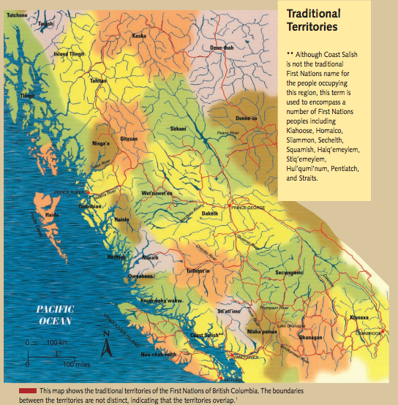

Slide 6
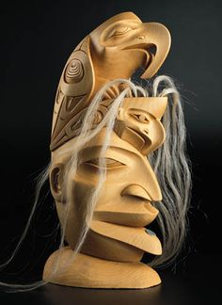
People of the Interior
Interior society was democratic and did not have a rigid class system.
Families associated together in a group sometimes called a band. This band name usually was associated to their territory. For example the Secwepemc peole living near Skola’ten or Williams Lake were the “People of the Skola’ten.”
Interior people had a head chief who acted more as a father or adviser than an all powerful leader. He was either picked hereditarily or by his abilities-but this was a temporary position.
The chief did not govern all- there were people chosen to lead in other areas of life. For example, the best hunter would lead hunting exhibitions, the most skilled warrior would lead warfare, etc.

Slide 7
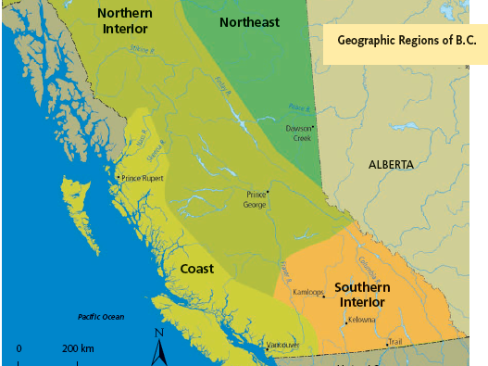

Slide 8
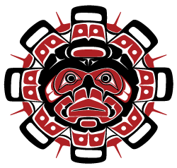
People of the Coast
Coast people are a very diverse group but do share some similar characteristics.
Coast nations had strict social codes with a very rigid hierarchy.
Chiefs were ranked highest in importance and a class system was made up of chiefs, nobles, commoners, and slaves.

