Slide 1
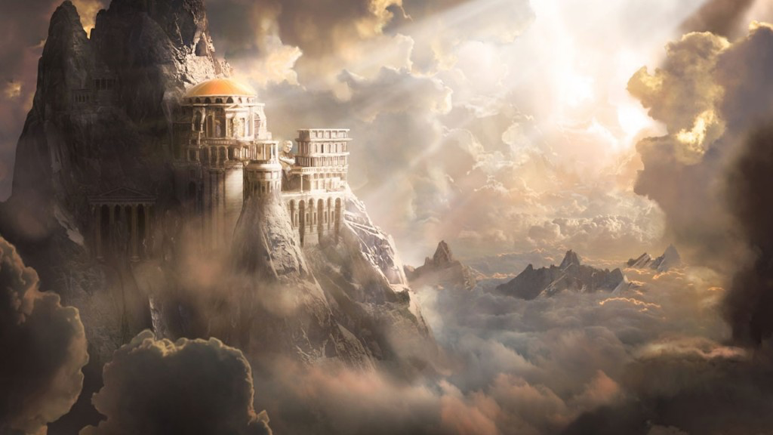
Greek Mythology

Slide 2
Greek Mythology
Sing, O goddess, the anger of Achilles son of Peleus, that brought countless ills upon the Achaeans. Many a brave soul did it send hurrying down to Hades, and many a hero did it yield a prey to dogs and vultures, for so were the counsels of Jove fulfilled from the day on which the son of Atreus, king of men, and great Achilles, first fell out with one another.

Slide 3
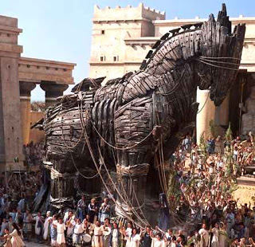
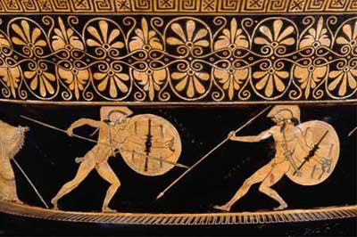
Greek Mythology
Thus begun the ‘Iliad’, one of the oldest works of literature in the western world
Set during the last year of the Trojan War, the ‘Iliad’ tells of the Greek hero Achilles, who follows King Agamemnon and the armies of Greece to the great city of Troy
According to the legend, the Greek gods and goddesses also took part in this war

Slide 4
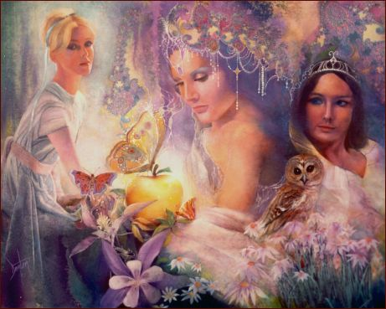
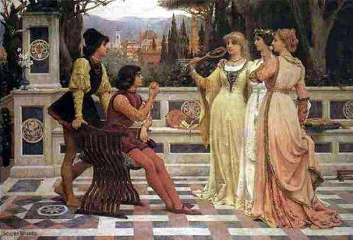
Greek Myth – The Iliad
Paris, Prince of Troy, had kidnapped/seduced
Helen of Sparta
Paris had been promised
any woman he desired after awarding Aphrodite the
Golden Apple and declaring her the most beautiful Goddess over Athena and Hera
Paris thus earned the wrath of both Athena and Hera

Slide 5
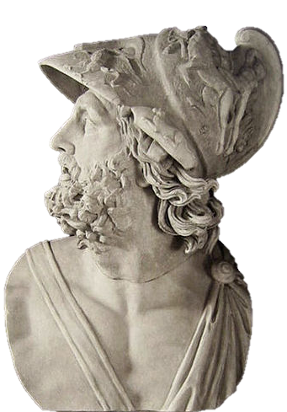
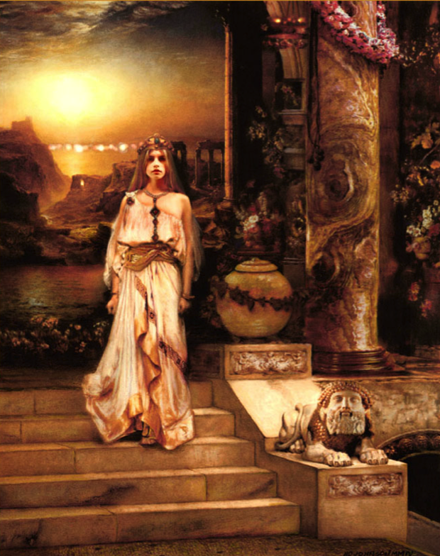
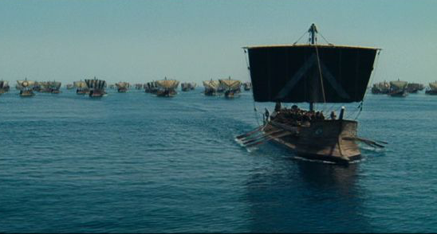
Greek Myth – The Iliad
Helen of Sparta (aka Helen of Troy) was said to be the most beautiful woman in the world
Many powerful Greeks courted her
To avoid war, the kings vowed to defend whichever man won Helen’s hand
King Menelaus of Sparta would
marry Helen
When Helen left with Paris all the
kings of Greece fulfilled their vow
and headed for Troy

Slide 6
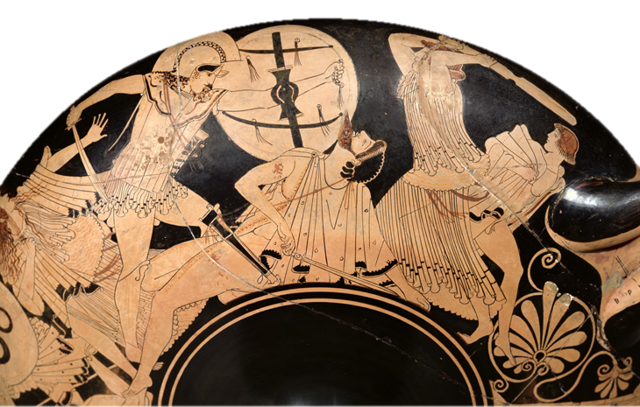
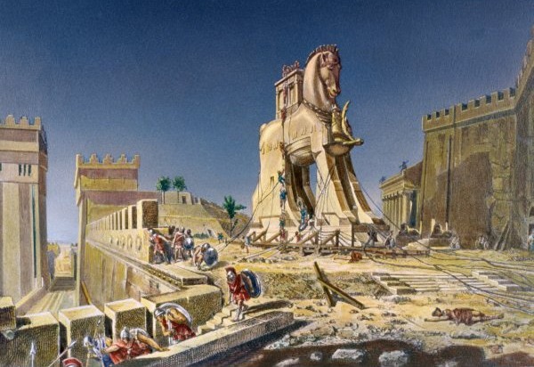
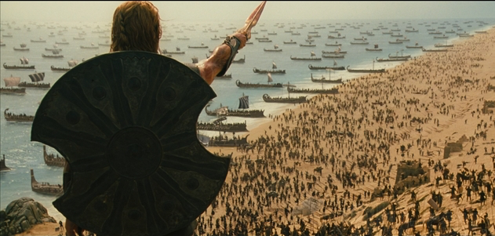
Greek Mythology
To the Greeks,
this legend was
not fiction but
history
Greek mythology formed the backbone of Greek identity while Greece remained divided politically

Slide 7
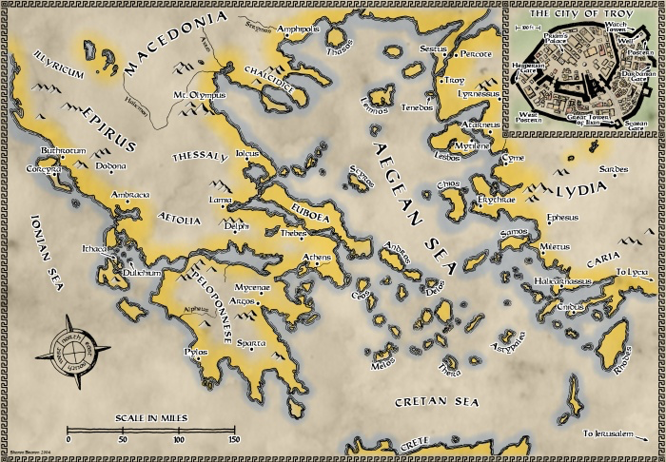
Mac’s History

Slide 8
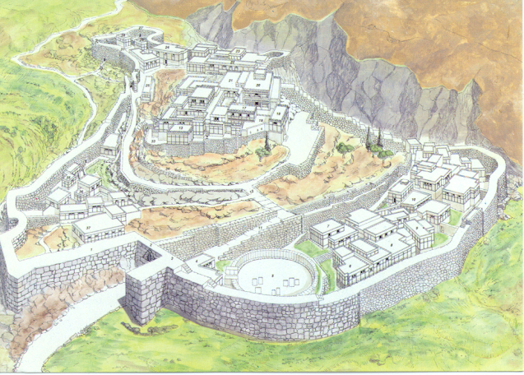
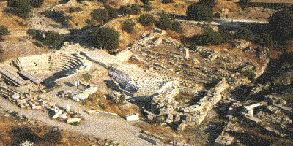
Greek Mythology - Troy
Archaeologists have determined that there was a city destroyed in battle
ca. 1240 BCE where Troy was thought to have been
It was a small, fortified town, barely two hectares in size with a poor standard of living
Likely destroyed over shipping or fishing rights

Slide 9
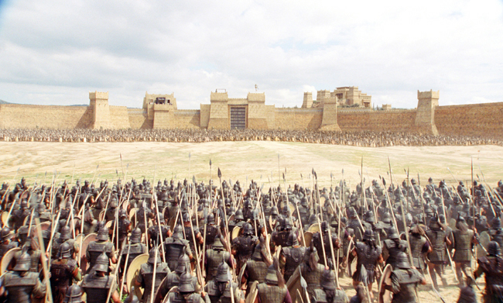
Greek Mythology - Troy
The Ancient Greeks
would have believed
Troy looked like this
This was the epic
struggle between
West and East in
which the heroic
Greeks would defeat
the treacherous Trojans

Slide 10
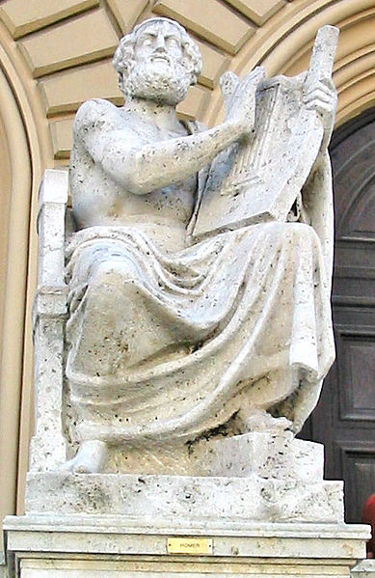
Greek Mythology - Homer
The ‘Iliad’, along with the ‘Odyssey’, are two poems thought to have been composed sometime between 750 and 650 BCE by Homer
Nothing is known of Homer as a person and there is some disagreement as to whether the same person wrote both poems

Slide 11
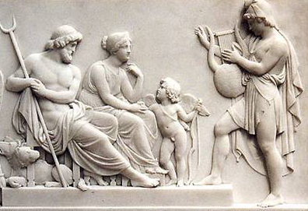
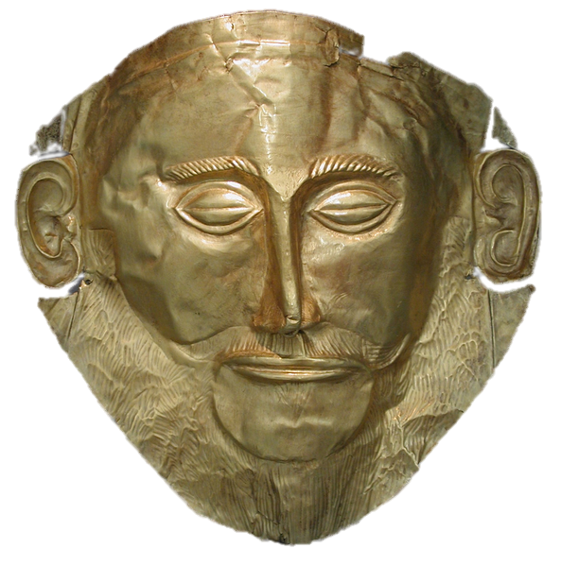
Greek Mythology
It is thought that the myths were shaped out of older stories handed down verbally by minstrels that
wandered from village to village during the Dark Ages of Greece
The myths and legends sung by the singer-poets of the Dark Ages of Greece (ca. 1100-800 BCE) about the glorious Mycenaean Age (ca. 1500-1200 BCE) gave the Greeks a sense of shared identity – Video 1

Slide 12
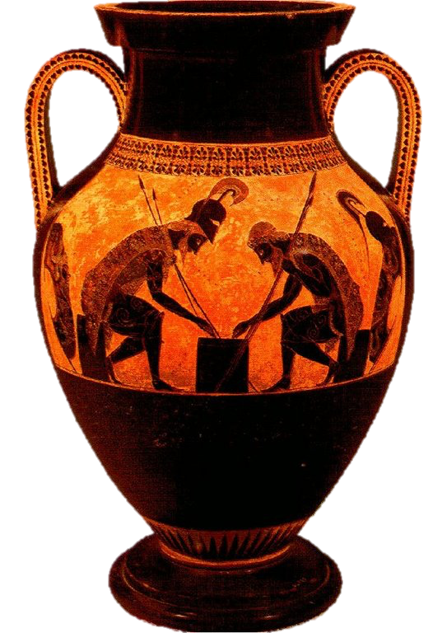
Greek Mythology
These myths would appear in many artistic forms – most commonly seen on vases and pottery
This vase shows Achilles and Ajax playing draughts – a game similar to checkers

Slide 13
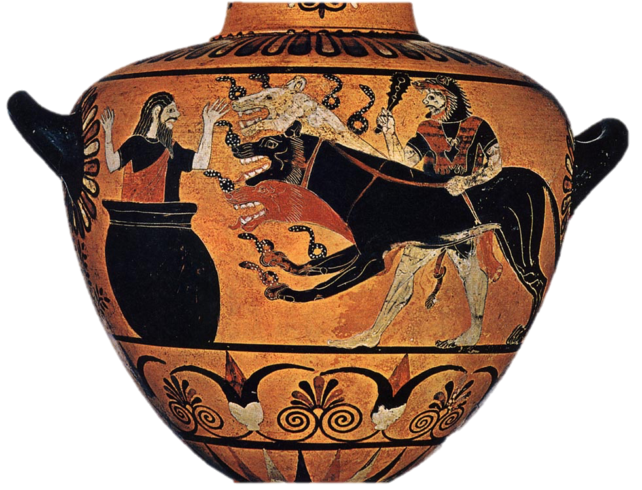
Greek Mythology - Heracles
One of the best-known Greek legends tells of the twelve labors of Heracles
This vase shows the last labor,
Heracles brings Cerberus, guard
dog of Hades, to King Eurystheus
– shown hiding in a large jar
Athena and Hermes had assisted
Heracles when he entered the Underworld
Stories such as these guided the Greeks in their daily lives

Slide 14
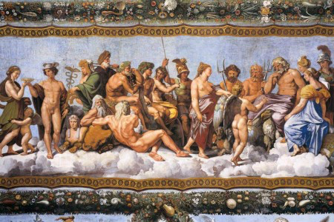
Greek Mythology
The Greeks have no word for religion, but they would come to believe that there were many gods and goddesses, each with responsibilities and domains on earth
The gods were like humans, but immortal and much more powerful

Slide 15
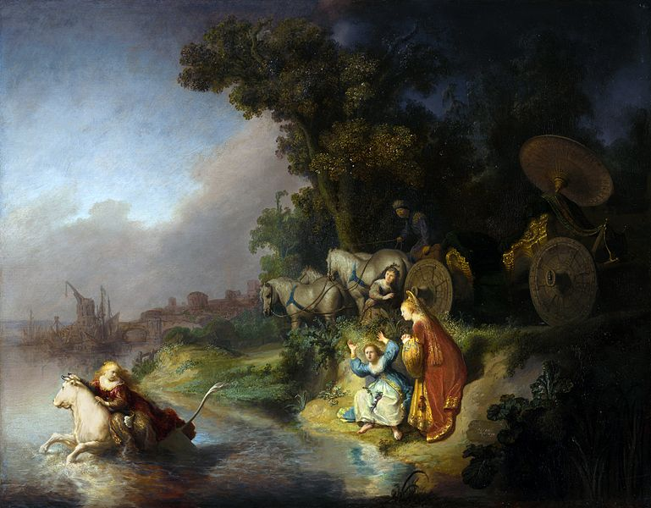
Greek Mythology – Gods and Goddesses
The gods also had human emotions and could act out of jealousy, lust, anger, and mercy
Zeus was an unfaithful husband and had numerous affairs with goddesses and humans
Many of his sons with human females became the heroes of myth such as Heracles

Slide 16
Mac’s History
Abduction of Europa
by Rembrandt
Zeus, having become
enamored of Europa,
decided to seduce and
ravish her. He
transformed himself into a tame white bull to hide amongst her herd and when she climbed onto his back he ran to the sea with her and swam to the island of Crete.

Slide 17
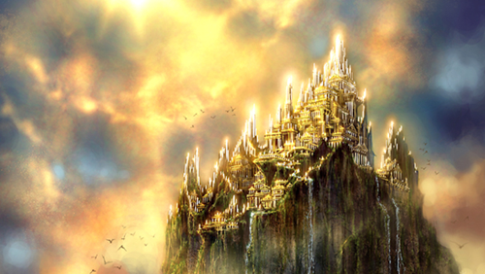
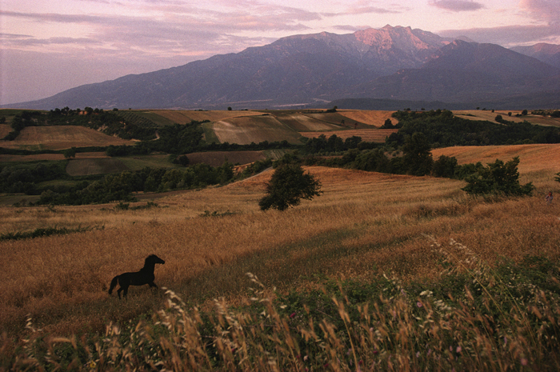
Greek Mythology – Gods and Goddesses
There were many gods and goddesses but twelve were seen as the most important
These twelve were mostly the brothers, sisters, and children of Zeus
They were believed to live in a sprawling palace on Mount Olympus

Slide 18
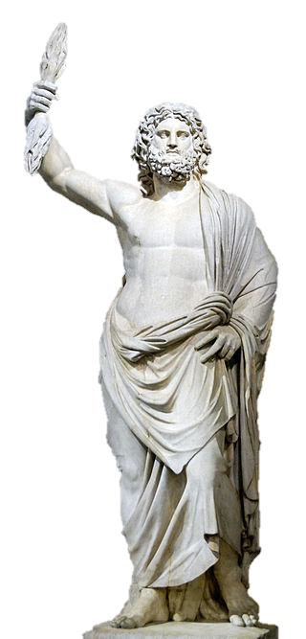
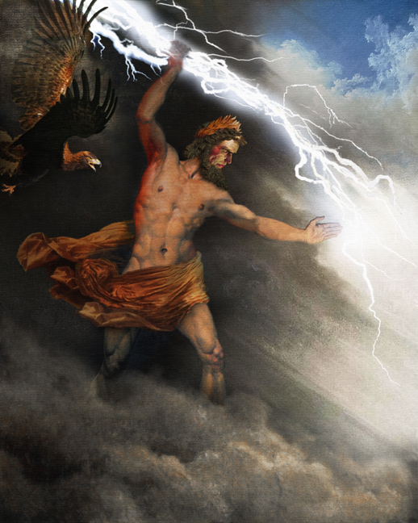
Greek Mythology – Gods and Goddesses
Zeus
King of the gods
God of the sky and thunder
Led the gods to victory against his father Cronus and the titans
Known for his insatiable lust, seducing many mortal women and goddesses causing many problems for mortals

Slide 19
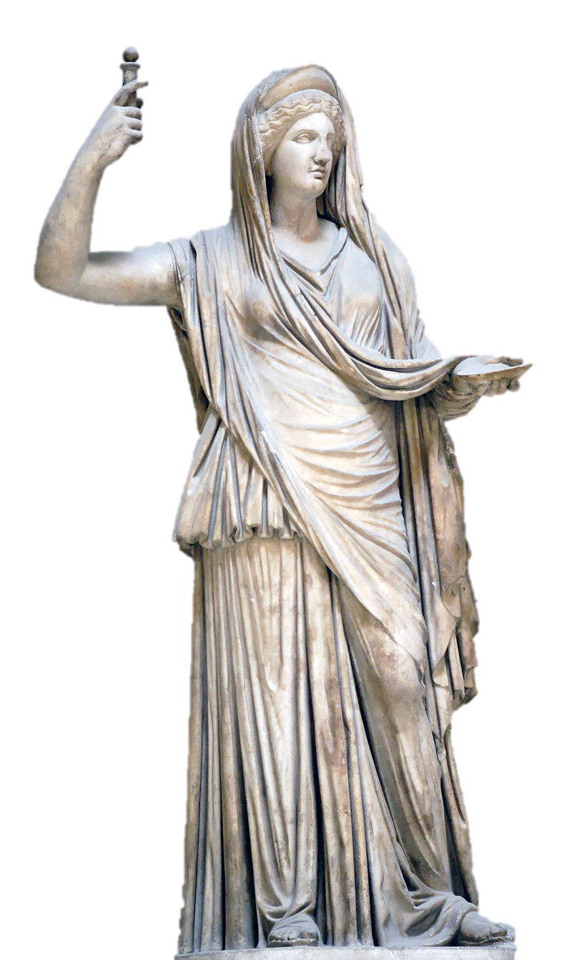
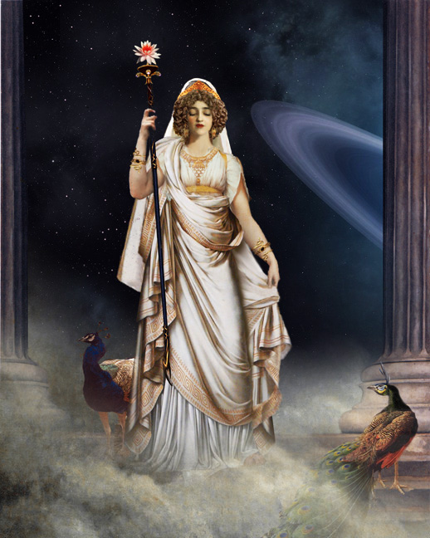
Greek Mythology – Gods and Goddesses
Hera
Queen of the gods
Goddess of marriage and of women
Wife and sister of Zeus
Jealous and vengeful against Zeus’ many lovers and offspring

Slide 20
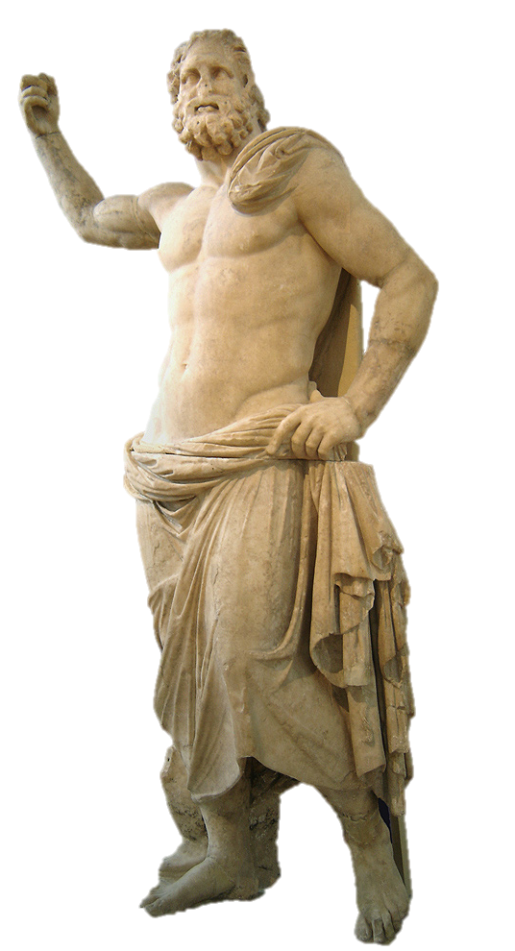
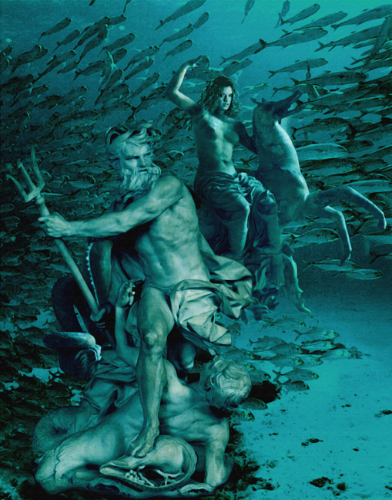
Greek Mythology – Gods and Goddesses
Poseidon
God of the sea and horses
Brother of Zeus
Known for his temper and feared as the bringer of earthquakes
A very important god to the Greeks as sailing was critical to their society

Slide 21
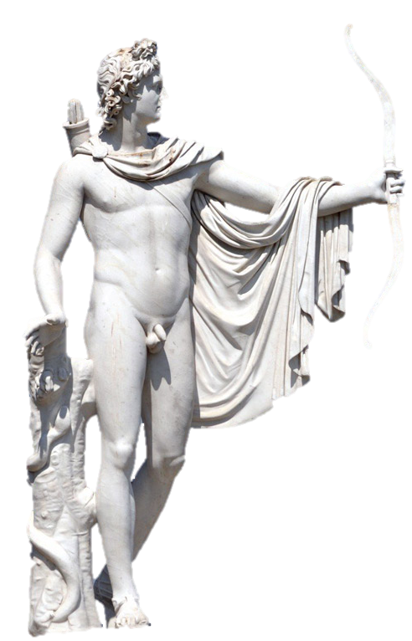
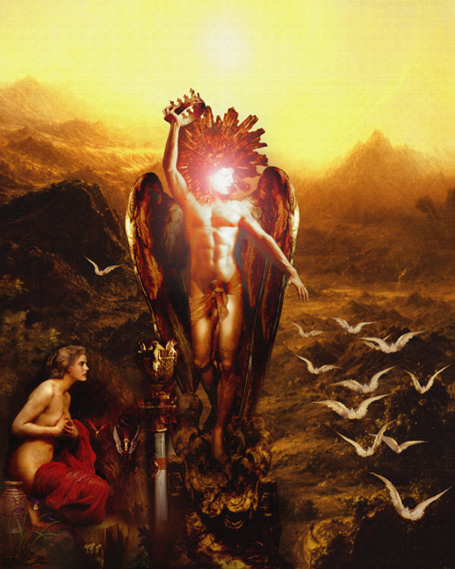
Greek Mythology – Gods and Goddesses
Apollo
God of the sun, truth, music, poetry, dance, and healing
Son of Zeus
A complicated god he was also one of the most beloved by the Greeks

Slide 22
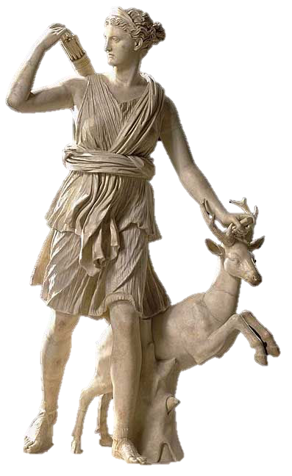
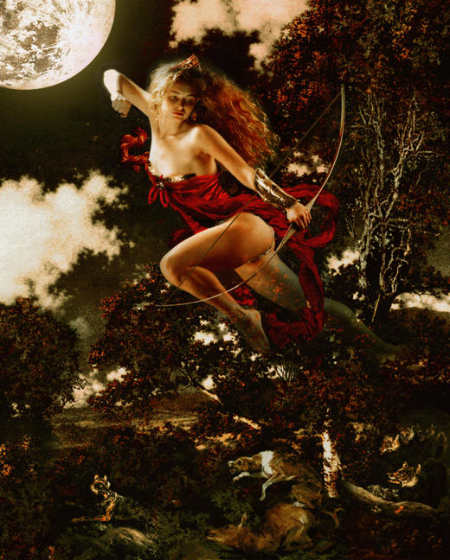
Greek Mythology – Gods and Goddesses
Artemis
Goddess of the hunt, archery, nature, chastity, and childbirth
Twin sister of Apollo and daughter of Zeus
Greatly revered by the Greeks
May have existed in pre-Greek times as a deity

Slide 23
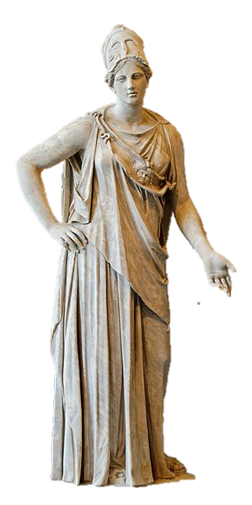
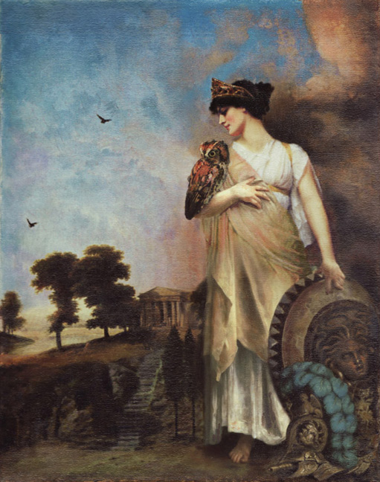
Greek Mythology – Gods and Goddesses
Athena
Goddess of wisdom, war, civilization, law
and justice, and more
Favorite daughter of Zeus, born fully armed from his forehead
Companion of heroes
Athens was named in her honor

Slide 24
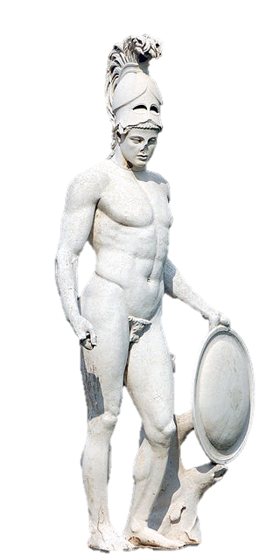
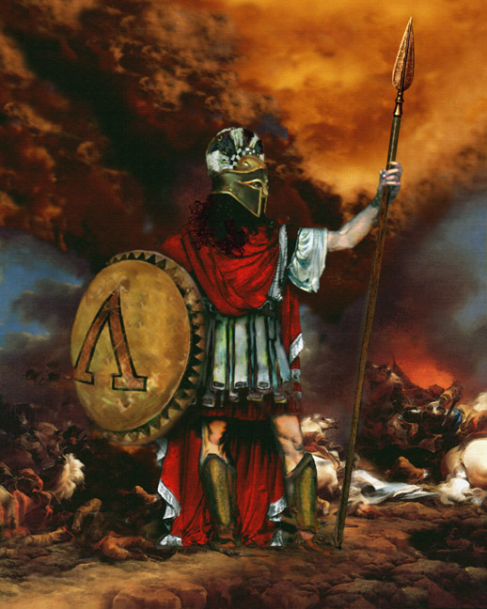
Greek Mythology – Gods and Goddesses
Ares
God of war and destruction
Son of Zeus and Hera
Represented the violent, brutal aspects of war
The Greeks did not love him but respected his strength
His sons were Fear and Terror

Slide 25
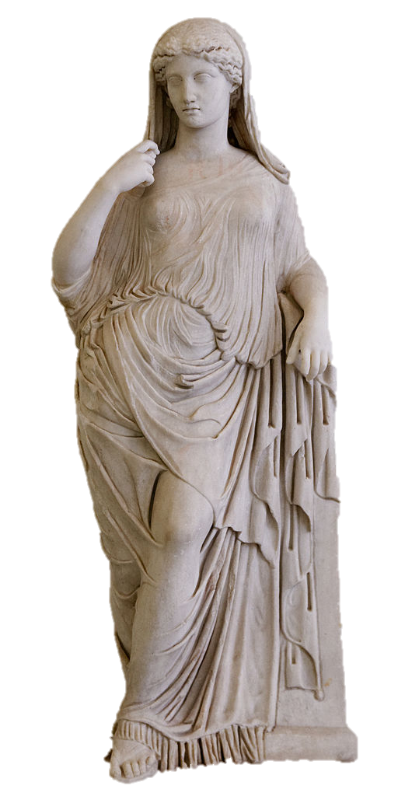
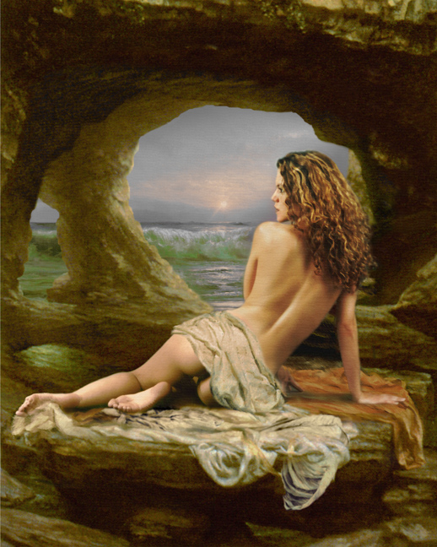
Greek Mythology – Gods and Goddesses
Aphrodite
Goddess of love and beauty
Daughter of Zeus in some myths, daughter of Uranus in others
Wife of Hephaestus but lover of Ares

Slide 26
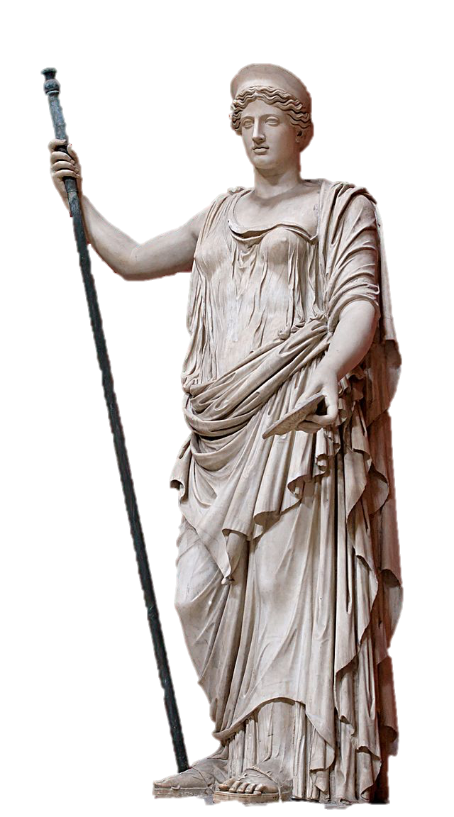
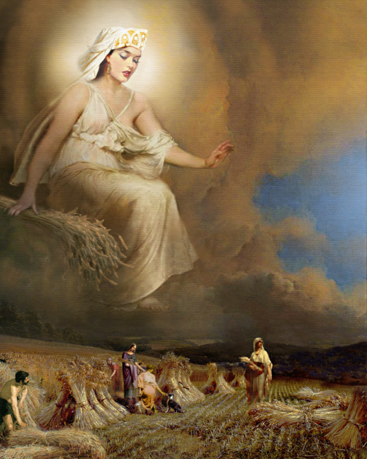
Greek Mythology – Gods and Goddesses
Demeter
Goddess of fertility and agriculture
Most important goddess for farmers and women
Sister of Zeus
Presided over the sacred law and the cycle of life and death

Slide 27
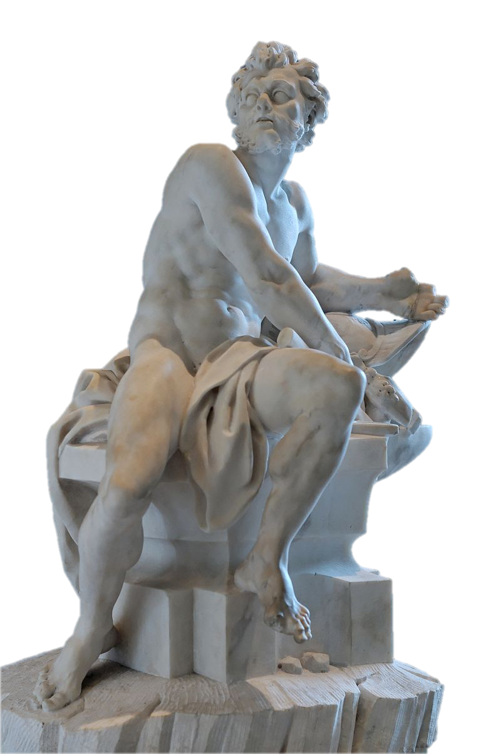
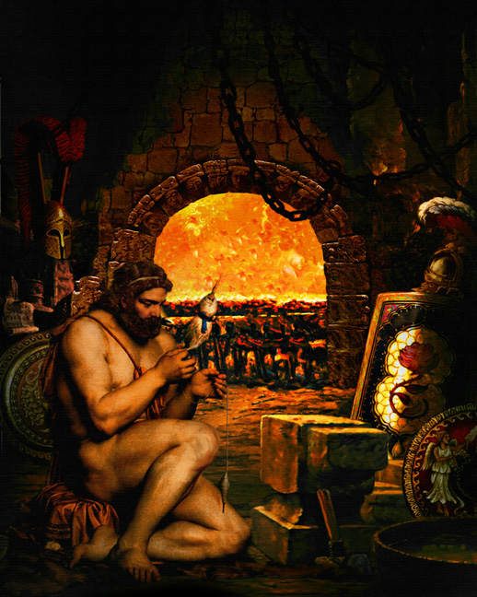
Greek Mythology – Gods and Goddesses
Hephaestus
God of fires, volcanoes, blacksmiths and craftsmen
Son of Zeus and Hera
Was ugly and deformed
Was the husband of Aphrodite – a marriage arranged by Zeus

Slide 28
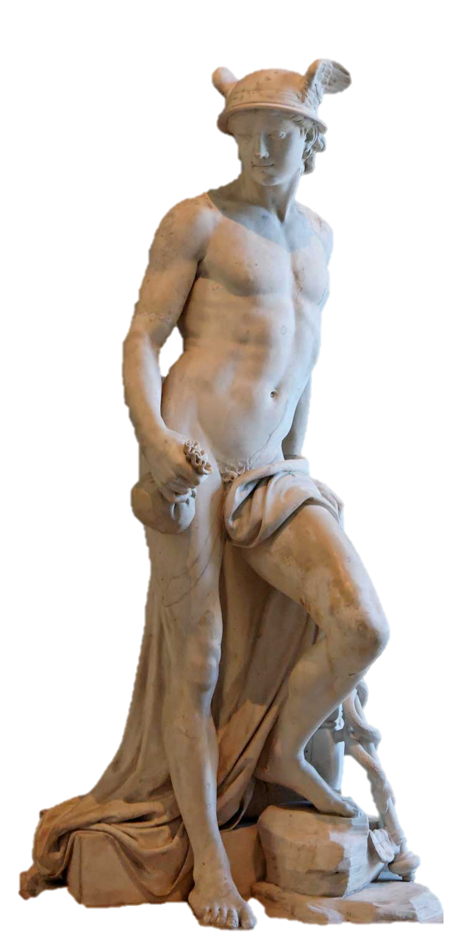
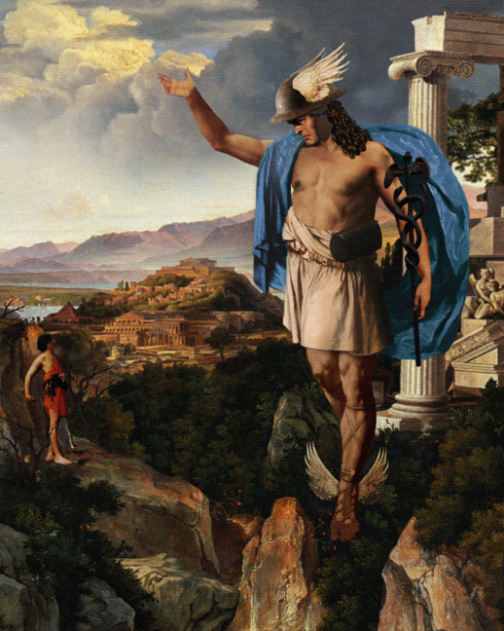
Greek Mythology – Gods and Goddesses
Hermes
God of travel, business, weights and measures, and sports
Messenger of the gods
Had winged feet
Was the son of Zeus

Slide 29
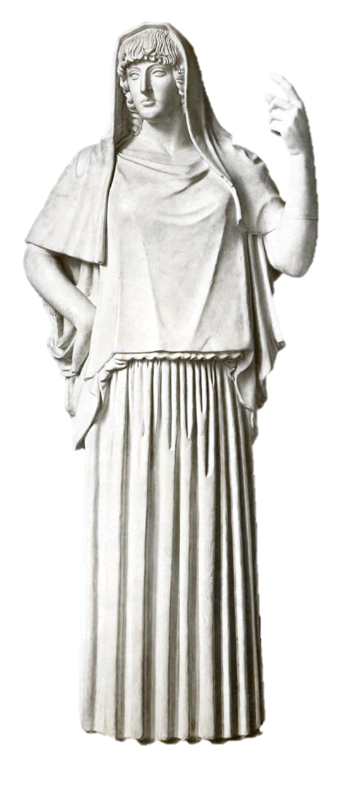
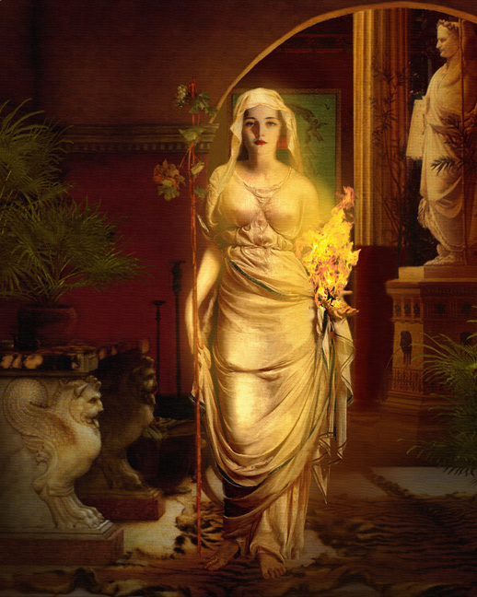
Greek Mythology – Gods and Goddesses
Hestia
Virgin goddess of the home and family
Sister of Zeus
Received the first offering at every sacrifice in the household

Slide 30
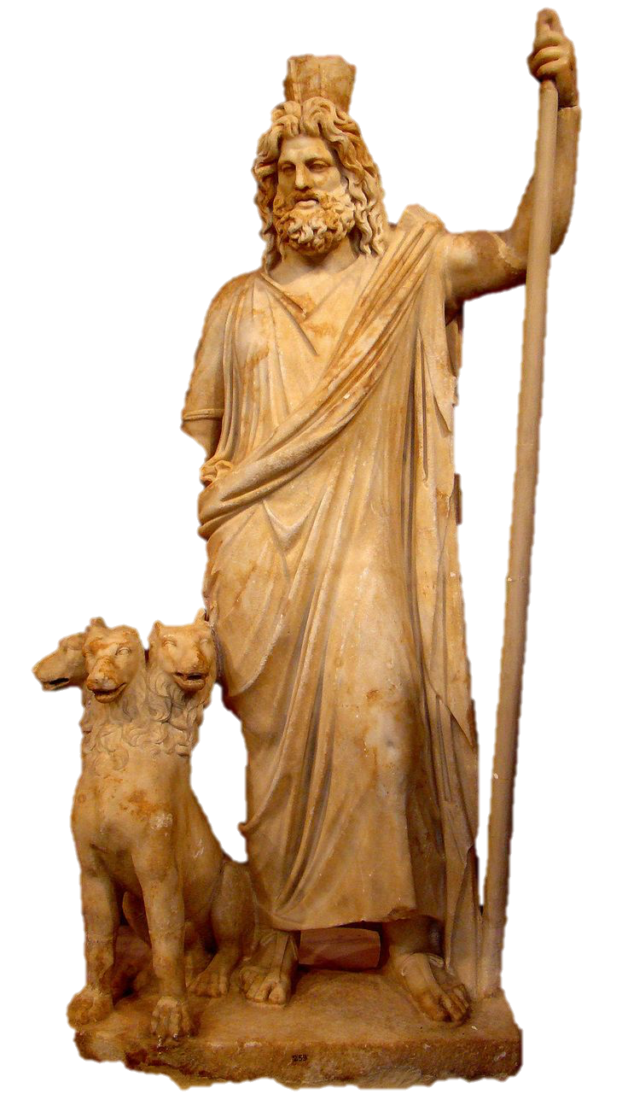
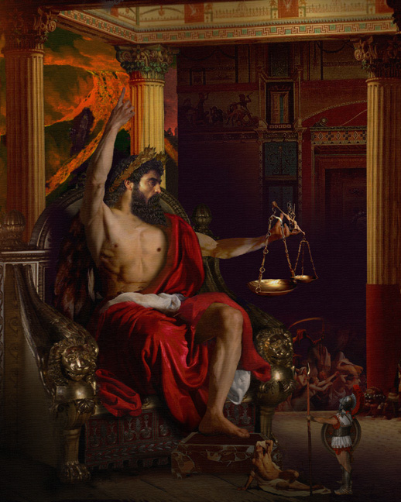
Greek Mythology – Gods and Goddesses
Hades
God of the Underworld
Not a part of the twelve Olympians and did not live on Mount Olympus
Helped his brothers Zeus and Poseidon in defeating their father’s generation of gods, the Titans

Slide 31

Greek Mythology – Gods and Goddesses
These gods and goddess could be kind and cruel, merciful
and vindictive, and above all temperamental
The Greeks believed they
must do their utmost to keep
the gods and goddesses appeased
These beliefs shaped the
myths and legends that developed in the Greek world

Slide 32
Greek Mythology - Heroes
Greek legends and myths that featured human heroes demonstrated the virtues that were valued in Greek society
The hero of the story must overcome some great trial through his intelligence and strength – women and goddesses were often the antagonists of such stories
This created a society where men were over glorified, and women were severely oppressed far more than many other ancient societies

Slide 33




Greek Mythology - Heroes
Achilles
Greek hero of the Trojan War
Central figure in Homer’s Iliad
Son of Peleus, king of the Myrmidons
Slain at the end of
the Trojan war by an arrow to the heel

Slide 34



Greek Mythology - Heroes
Odysseus
Greek hero during the Trojan war
King of Ithaca
Key figure in Homer’s Iliad and main character in the Odyssey
Known for his brilliance, guile, and versatility
Took ten years to return home after the Trojan war as a result of angering Poseidon

Slide 35




Greek Mythology - Heroes
Perseus
In Greek mythology was the first hero and founder of Mycenae
Beheaded the Gorgon Medusa, saved Andromeda from the sea monster Cetus
Mortal son of Zeus
Great grandfather of Heracles

Slide 36



Greek Mythology - Heroes
Theseus
The slayer of the Minotaur
Son of Aegeus, king
of Athens
Overcame many trials on the road to Athens that demonstrated his cunning and strength

Slide 37



Greek Mythology - Heroes
Heracles
Most famous Greek hero
Son of Zeus and Alcmene, a mortal woman
Hated by the goddess Hera
Renowned for his great strength but also
incredibly courageous
and cunning
Known as Hercules by
the Romans

Slide 38


Greek Mythology
Each town and village was dedicated to a god or goddess who was worshipped on a regular basis
Almost every group or gathering, including families, towns, sporting events, feast days, weddings, and funerals, was a religious event

Slide 39

Greek Mythology
Sacrifices were an important part of worship
The victim was typically an animal, although other gifts, such as cakes or fruit, were also common
Below is an image of a lamb being led to the altar for sacrifice
The picture, painted
on wood, was found
in the Pitsa cave at
Corinth and dates to
over 2,500 years ago

Slide 40


Greek Mythology - Sanctuaries
Sanctuaries were important
places of worship
Dedicated to a god or
goddess in gratitude for a fortunate event
Some had temples, gates
and walls; others were simply marked out on the ground with a row of stones
There were hundreds throughout Greece

Slide 41
Mac’s History

Slide 42

Greek Mythology - Temples
Temples would be built inside a sanctuary, though not all sanctuaries had temples
Earliest temples, built around the 10th to 8th centuries BCE, were simple wooden huts
As the Greeks became richer and more skilled in architecture the temples became true marvels of the ancient world

Slide 43

The Parthenon
The Parthenon is perhaps the most famous Greek temple
Dedicated to the Goddess of Athens, Athena
It still stands today

Slide 44

The Parthenon

Slide 45

Mac’s History

Slide 46


Greek Mythology - Oracles
Many sanctuaries also had oracles
People came to consult the oracles to find out about the future
Most important decisions, such as whom to marry, business and trade deals, and even when to
go to war were made after
seeking advice from the oracles

Slide 47



Greek Mythology – Conclusion
The mythology of the Greeks inspired them in some of their greatest theater, art, architecture, and philosophy
Without Greek mythology to shape the warrior culture of Greece the Western World
would be a very different place
Greek mythology continues to influence our stories and sense of wonder to this day

