Slide 1
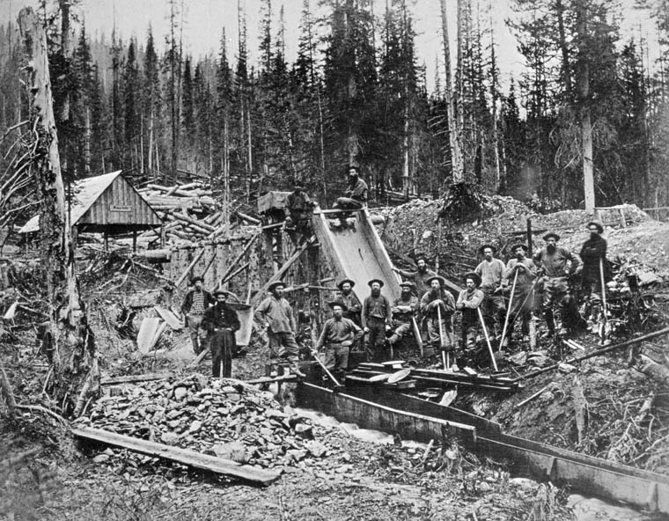
The Colonial Era (1849-1871)

Slide 2
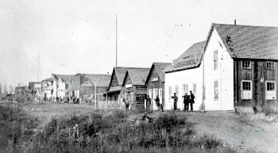
The Times Change
The fur traders who lived and worked on First Nations territory in B.C made a huge impact economically but never attempted to impose their own laws or regulations on the First Nations people and their land.
In the 1840’s the British government began to exert more direct control over the fur-trading areas of B.C.
The impacts of this control would impact the land, lives, and future of the First Nations people of B.C and put into motion a cycle of COLONIALISM: The control or governing influence of a territory by another territory perceived by others and themselves as “better” or more advanced.

Slide 3
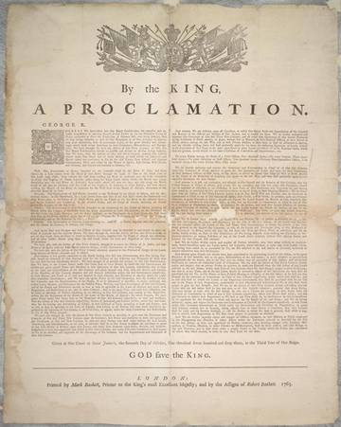
The Royal Proclamation of 1763
A document that set out guidelines for European settlement of Aboriginal territories in what is now North America. This contained Britain’s general policies for dealing with First Nations people in the N A Colonies.
Ownership over North America is given to the King.
States that all land is to be considered Aboriginal land until treaty is reached.
Only the Crown (the Royals) can buy land from Aboriginals.
Set the foundation for establishing treaties EXCEPT in B.C
WHAT WAS PROMISED WAS NEVER UPHELD

Slide 4
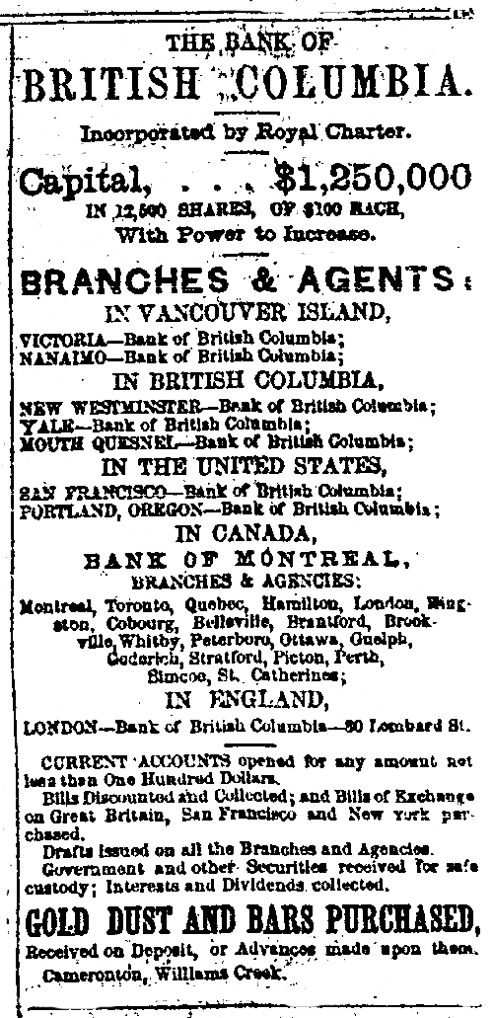
Colonial Precedents
The development of a colonial government in B.C came much later than those established in the rest of Canada.
There were steps, some outlined in the Royal Proclamation, that the British Empire could have followed. They did not do this in B.C.
Shifting attitudes towards Aboriginal peoples, the desire for trade, massive greed, the timing of the settlement of B.C, and the race to establish British Colonies in North America were some of the reasons that the British leadership in B.C did not follow the Royal Proclamation.

Slide 5
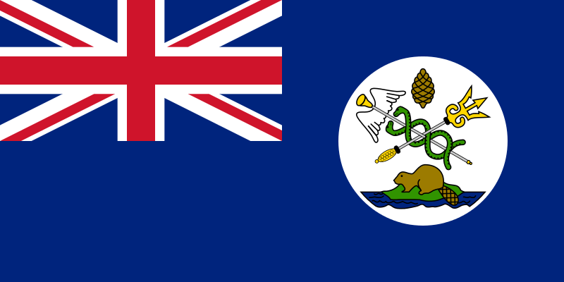
From Fur Trade to Gold Rush
The fur trade economy began to shift in B.C as the Gold Rush economy emerged
In the 1840’s the U.S expanded west, forcing the Hudsons Bay Company to move its head quarters from Fort Vancouver to Fort Victoria in 1843.
The new site had a large harbour and rich agricultural land so it was a good fit.
The British parliament wanted to keep the Americans away from further advancement so they established a colony on the coast.
In 1849 Fort Victoria became the capital of the new colony of Vancouver Island.
The colonial office in London leased the colony to the Hudsons Bay Company for 10 years which meant they would not only run the colony itself, but would also control trade.

Slide 6
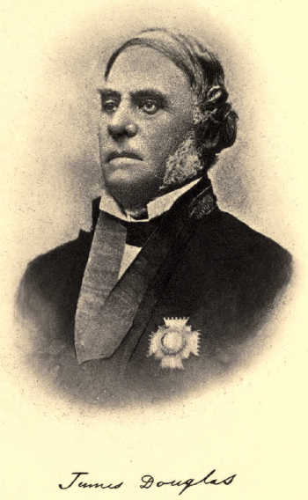
New Leadership of the Vancouver Island Colony
The first British governor of the colony was a man named Blanshard, but it soon changed hands and James Douglas, a long time HBC employee, took control.
He would continue to work for the HBC and became Governor of the colony of Vancouver Island.
The colony of Vancouver Island was established without the consent of the First Nations groups who lived there.
Furs were still the main trade item, but First Nations groups realized that the HBC was also trading in minerals, particularly coal and gold.

Slide 7
The First Deceptions
The Kwakwa-ka’wakw and the Snuney-muxw traded small amounts of coal with the HBC and pointed out the sources where they found the minerals.
Instead of trading with the First Nations peoples on their own territory, the HBC created their own mining division and built camps in Fort Rupert and Nanaimo.
In 1850, First Nations people along the Fraser river traded small amounts of gold with the HBC.
Douglas tried to keep the found gold a secret, fearing a big gold rush like the one in California that had created huge lawlessness and hysteria.
The news leaked out in 1858 and thousands of miners, mostly American, flooded into Victoria, heading for the Fraser River.
The Sto:lo people called these new miners “the hungry people,” or the “starving people” due to their greedy need for gold.

Slide 8
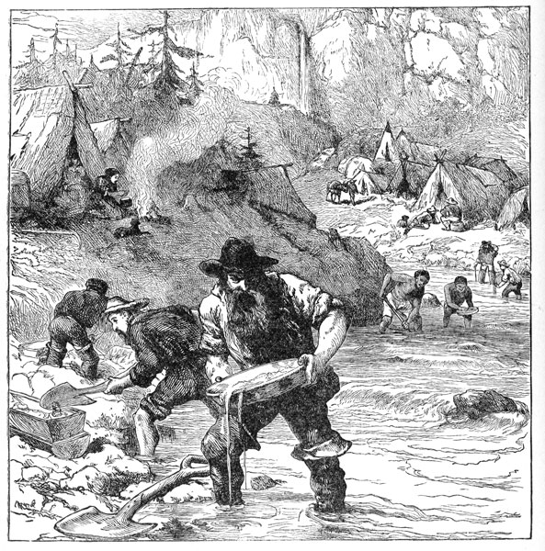
Expansion of the Gold Rush
As time went on the gold rush moved up the coast to Hope and Yale and further up into the Cariboo and Barkerville.
When gold was all gone in one area, the miners would simply move and take it all from another area.
The thousands of people searching for fortune showed no respect for the First Nations and made a mess of their traditional fishing rivers and placed settlements on their land.
First Nations people became miners too, working alongside miners from other countries. Many opposed them because they were competition.

Slide 9
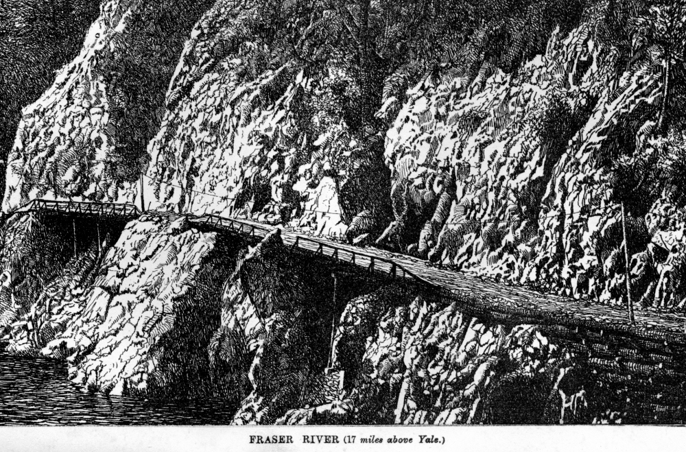
The Colony of British Columbia
Because Douglas feared lawlessness in Vancouver, he created a new colony on the mainland called British Columbia.
Its headquarters would be at New Westminster
Both colonies were opened up to huge amounts of settlers.
Transportation routes were created to allow these new inhabitants easier travel.
Small scale gold rushes occurred at the Stikine, the Omineca, the Peace Rivers, and in Kamloops and Victoria.
Roads were built to allow greater access between the colonies and from the settlements to the mining areas.

Slide 10

The Colonies Join
James Douglas continued to run both colonies until 1864.
Running both of these colonies became too expensive, so in 1866 the two were joined under the name British Columbia.
The capital of this new colony would be Victoria.

